Slide 1
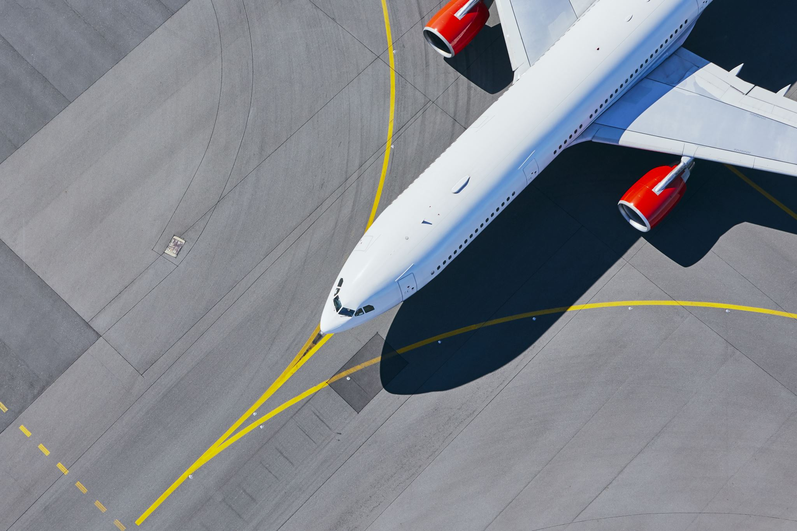
Internship Project on India Airline Optimization
By: Adetutu Adejuyigbe
Data Analyst
March Cohort 2023

Slide 2

Introduction
I am fully aware of the immense importance of optimizing airline operations within the fast-paced and competitive aviation industry. This report conducts an in-depth analysis of India airline routes and pricing strategies, with the goal of uncovering opportunities for improvement and maximizing overall performance. Utilizing my comprehensive analysis, I present data-driven insights and solutions to enhance the airline optimization and drive enhanced performance. The primary objective of this report is to identify crucial patterns, trends, and performance indicators that will effectively inform decision-making across various aspects of airline operations.

Slide 3
Methodology
I employed Power BI to conduct a thorough analysis of the airline dataset, aiming to extract valuable insights and propose recommendations for optimizing airline operations and enhancing the customer experience. My proficiency in utilizing Power BI was honed during my tenure at 10alytics, where I acquired essential skills in data visualization and analysis. The key findings from my analysis are as follows:

Slide 4
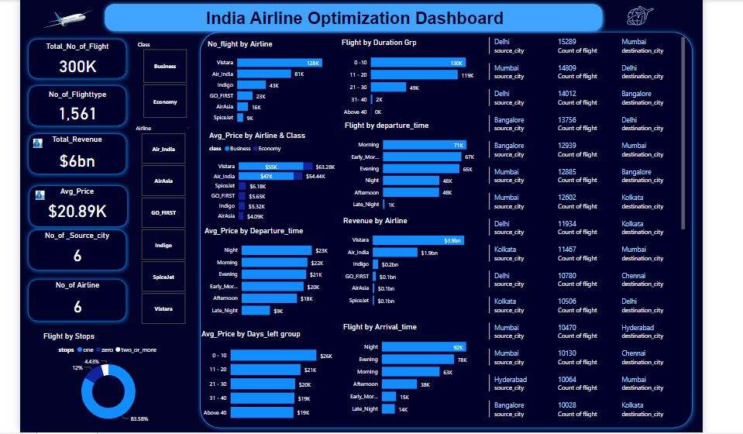

Slide 5
Flight Performance
The airline operates approximately 300,000 flights, generating a total revenue of around $6 six billion and there are 1,561 unique flight numbers representing different aircraft in the dataset.
Morning departures are the most frequent, comprising around 71,000 flights, while late-night departures are the least with approximately 1,000 flights.
Nighttime arrivals are the most common, accounting for approximately 92,000 flights, while late-night arrivals are the least with around 14,000 flights.
Flights with durations ranging from 0 to 10 hours are the most prevalent, totalling around 130,000 flights.
Most passengers prefer flights with one stop, representing a high percentage of about 83.58% of all flights.

Slide 6
Airline Performance
My analysis reveals that among the airlines, Vistara stands out with the highest number of flights, totalling approximately 128,000, and the highest revenue generation of about $3.9 billion. On the other hand, SpiceJet has the lowest number of flights, approximately 9,000, generating revenue of around $0.1 billion.
Furthermore, in terms of business class, Vistara and Air India were the only airlines offering this service. Vistara had an average price of $55,000 for its business class, while Air India's business class had an average price of $47,000.

Slide 7
Route Optimization
From the source city to the destination city, the route with the highest number of flights is from Delhi to Mumbai, with approximately 15,289 flights.
On the other hand, the route with the least number of flights is from Chennai to Hyderabad, with approximately 6,103 flights.
These findings highlight the varying demand and popularity of different flight routes, which can be valuable for optimizing airline operations and planning route schedules.

Slide 8
Pricing Analysis
Night departures had the highest average price, approximately $23,000, followed by morning departures with a total of $22,000. Late-night departures had the lowest average price of $9,000.
Additionally, the analysis of flight booking times and price averages revealed that flights booked within the range of 0-10 days left before departure had the highest average price, approximately $26,000. On the other hand, flights booked with more than 40 days left had the lowest average price, around $19,000.

Slide 9
Recommendation
Increase the number of flights during night and morning departures to meet customer demand, as these periods command higher average prices. Also, implement promotional offers or discounts during late-night departures, which have the lowest average price, to attract more bookings and increase revenue.
For route optimization, consider adjusting or discontinuing flight routes with lower revenue to optimize overall profitability.
Improve business class offerings for Vistara and Air India to cater to premium travellers and increase revenue.
Offer personalized services based on customer feedback and data to enhance satisfaction and loyalty.
Identify opportunities for ancillary revenue (add-ons, upgrades, travel packages) to increase revenue beyond ticket sales.

Slide 10
Summary
By implementing these recommendations, the airlines in India can optimize their operations, improve profitability, and provide exceptional customer experiences, leading to a more competitive position in the aviation industry.

Slide 11

Thank you

